Slide 1

Passive Ranging Maneuver Pattern of Life and Characterization

Slide 2
Passive Ranging Overview
Passive RF ranging uses the RF signals transmitted by the satellite to determine its position and velocity (i.e., ephemeris). The RF signal must be received by at least three ground antennas located at least several hundred miles apart from each other. Ideally, the three antenna sites are positioned so that they are separated by a large distance both latitudinally and longitudinally. This ensures that the difference of arrival (DOA) measurements are distinguishable. The RF signal from the satellite is digitized, time-tagged, and recorded at each antenna site. The recorded RF data is transferred to a central processing location where cross-correlation is performed using a cross-ambiguity function (CAF). The CAF performs cross-correlation between the RF signals with varying time difference of arrival (TDOA) and frequency difference of arrival (FDOA) values, returning the TDOA and FDOA values which produce the strongest correlation between the recorded RF signals. These TDOA and FDOA values are the foundational measurements of passive RF ranging. The TDOA values indicate how much longer the RF signal took to arrive at one site relative to another site. This corresponds to the difference in distance from the satellite to each site. The FDOA values indicate the difference in received Doppler shift between one site relative to another site. This corresponds to the difference in relative speed between the satellite and each site. These TDOA and FDOA measurements are taken repeatedly over time and are then fed into a non-linear orbit determination process. Currently we produce state vectors by using a batch least-squares method. The state vector describes the satellite’s position and velocity at a specific time. Paired with a propagation model, this SV can be used to predict future positions of the satellite. A major obstacle to accurately modeling the satellite’s motion are satellite maneuvers. Whenever a satellite actively produces thrust to maneuver, the resulting delta-v (change in velocity) must be included in the model of the satellite’s movement. Alternatively, all measurements before the maneuver completed must be excluded from the orbit determination process. As a result, maneuver detection is an important component of passive RF ranging.

Slide 3
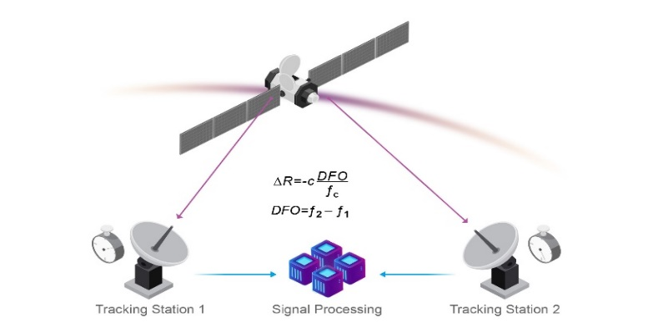
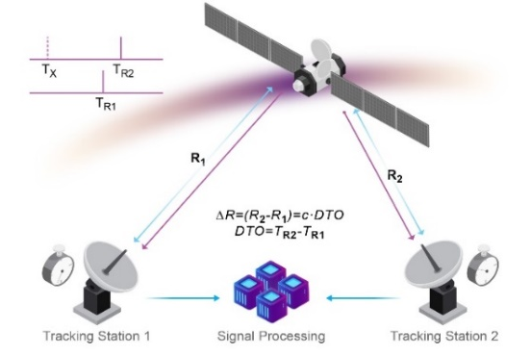
Tracking Station 1 will see the radio transmission before Tracking Station 2 does (TDOA)
Tracking Station 1 will see a lower frequency signal (less bunched up) than Tracking Station 2 will (FDOA)
From this data it is possible to determine where the satellite is at any moment and doing this over time results in the satellites position and velocity vectors

Slide 4
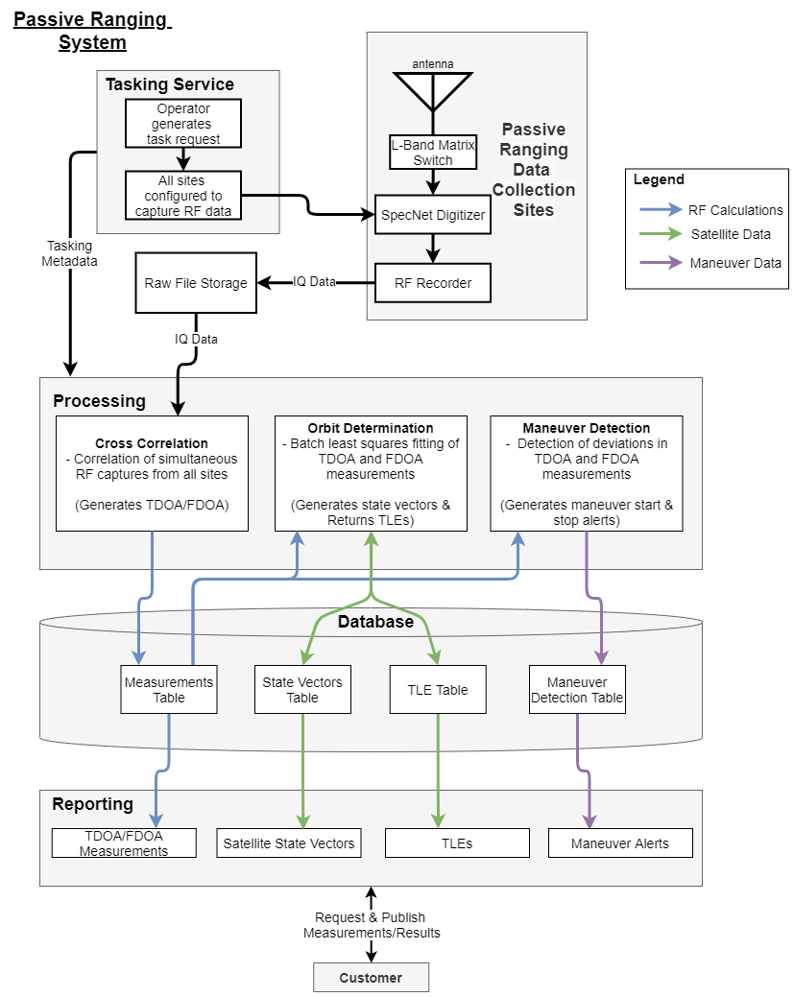
You’ll be working on this piece

Slide 5
Interests
The start and stop time of a maneuver given TDOA and FDOA data
Whether maneuvers are normal or abnormal. This is called “Pattern of Life”
Magnitude of satellite maneuvers given by the change in velocity or delta-v
Anything else which your algorithm could glean from the input dataset

Slide 6
Deliverables (what we want from you)
We’re interested in seeing how well a machine learning approach could determine when a maneuver has occurred, how large the maneuver is, and how normal the maneuver was given TDOA and FDOA data
We want you to develop and explore different approaches to this problem
Because we’re exploring options, creativity is encouraged
At the end of the project, we’d like a presentation on your findings
About 7 minutes of presentation and 3 minutes for questions
Cover what worked and what didn’t work
How accurately could you predict maneuvers?
What distinguishes your approach from the other teams’?

Slide 7
Data Sets (what we’ll give you)
TDOA and FDOA data for 30-40 satellites over several months
Real maneuver data for 3 satellites
The results of our Batch least squares residual from best fit algorithm on all 30-40 satellites
This can be used to determine when we detected a maneuver using our algorithm
This is not 100% accurate

